Slide 1
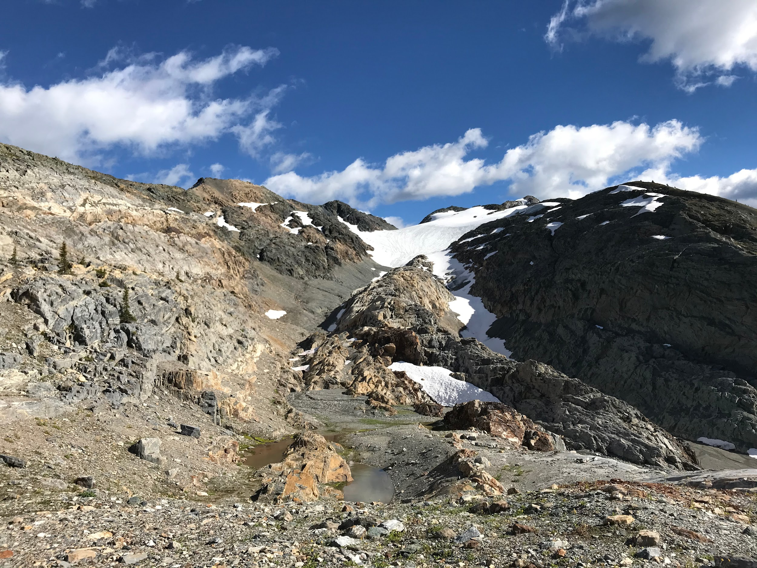
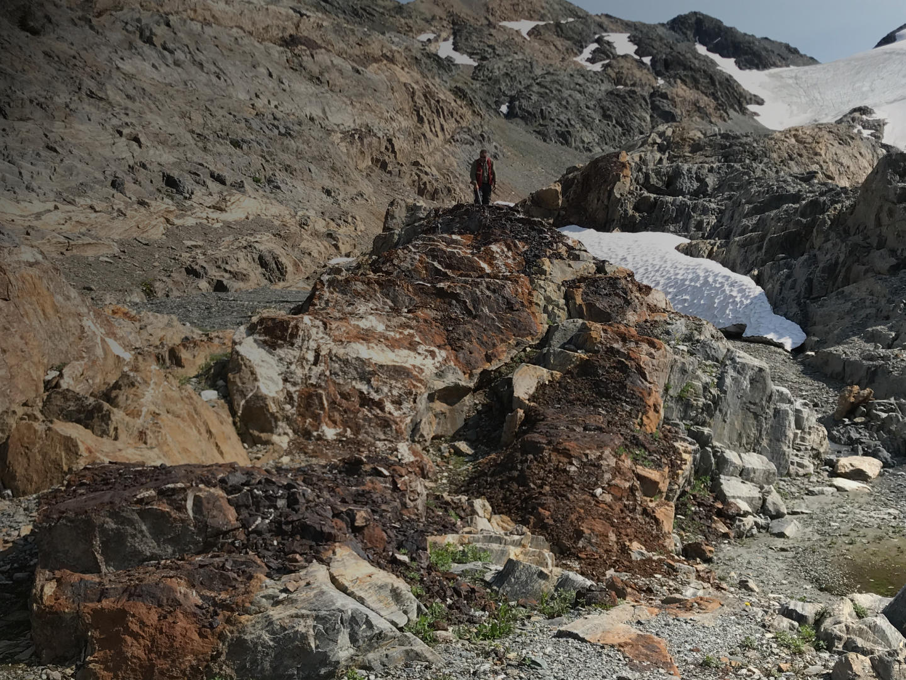

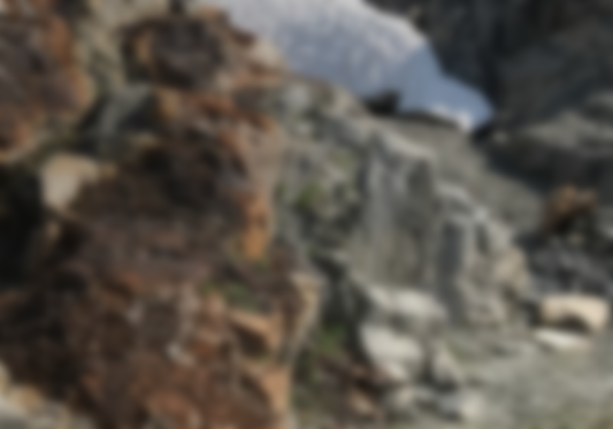
CSE: WSR
Discovering
Silver, Gold, Copper
& Green Metals
to Power New Technologies
47
79
29
27
Ag
Au
Cu
Co
SILVER
GOLD
COPPER
COBALT
107.87
196.97
63.55
58.93
September 2023

Slide 2
Certain statements in this Presentation relating to the Company's exploration activities, project expenditures and business plans are approximate and are "forward-looking statements" within the meaning of securities legislation. The Company does not intend, and does not assume any obligation, to update these forward-looking statements. These forward looking statements represent management's best judgment based on current facts and assumptions that management considers reasonable, including that operating and capital plans will not be disrupted by issues such as adverse market conditions, mechanical failure, unavailability of parts, labor disturbances, interruption in transportation or utilities, or adverse weather conditions, that there are no material unanticipated variations in budgeted costs, that contractors will complete projects according to schedule, and that actual mineralization on properties may not achieve any category of resource(s). The Company makes no representation that reasonable businesspeople in possession of the same information would reach the same conclusions. Forward looking statements involve known and unknown risks, uncertainties and other factors which may cause the actual results, performance or achievements of the Company to be materially different from any future results, performance or achievements expressed or implied by the forward-looking statements. ln particular, fluctuations in the price of gold, equity markets or in currency markets could prevent the Company from achieving its targets. Readers should not place undue reliance on forward-looking statements. There is no guarantee that drill results reported in this news release or future releases will lead to the identification of a deposit that can be mined economically, and further work is required to identify resources and reserves. We seek safe harbour. The technical information in this presentation have been reviewed and approved by an Independent Qualified Person defined by National Instrument 43-101: Derrick Strickland, P.Geo. (1000315). September 9, 2023. Mineralization on adjacent Properties may not be indicative of Western Star Properties.
Forward Looking Statement

Slide 3




Management
Leadership
Blake Morgan - CEO, Director
Team has supported and been successful in raising over 150 million CAD for junior mining companies.
Working decades in various capacities with Major producers in the Natural Resource sector such as: Rio Tinto; BHP Billiton & Santos Ltd in various global locations
Dynamic Team spearheaded by Blake Morgan as CEO, who has taken numerous companies public in the United States, Canada, & Germany.
Exceptional collective ability to drive exploration operations towards discoveries.
Blake Morgan has over 15 years’ experience in Capital Markets, specifically in the Natural Resource and Precious Metals sector, including 10 years with Rio Tinto, BMA Metals (a subsidiary of BHP) and Santos Ltd. Mr. Morgan is a prominent Board Member in numerous publicly traded companies. Mr. Morgan was the president of Origen Resources for numerous years recently stepping back once a world class board was put in place. Mr. Morgan has raised tens of millions of dollars in recent years for both Public and Private companies alike.
Monty Sutton - CFO
Mr. Sutton has worked most of his career as an Investment Advisor, Equities Trader, and Insurance Specialist with PI Financial Corp. in Vancouver. During this time, he participated in raising over $100m for junior mining companies and managed over 1,500 client accounts. Since leaving PI, Mr. Sutton was the Corporate Development Manager with eCobalt Solutions where they raised over $30m for the companies Idaho Cobalt Project. Mr. Sutton has also been working with small private companies in various consulting and advisory roles. Prior to joining PI in 1997, Mr. Sutton was a Senior Management Accountant with MacMillan Bloedel; preparing budgets, analyzing costs, and assisting in the design and implementation of new accounting systems.
Experience
Justin Corinella - Director
Mr. Corinella has a broad background in public markets and corporate financing. His focus is on early-stage venture companies with potential for large growth, scalability, and value creation. Mr. Corinella was the Head of Technology for CSE listed Squire Mining Ltd., and as part of the executive team, he participated in raising $28m in financing, and developed strategic partnerships with key stakeholders in North America, Europe, and Asia. Mr. Corinella is the inventor and Co-founder of Dahrwin LLC. , Dahrwin is a wireless technology company based out of New York, founded in 2012. The company raised venture funding, spearheaded software & hardware development, and received five issued patents. His endeavors have positioned him as a lead in multiple R&D and Engineering departments working on various US military and government-based technologies.
Dallas Miller - Director
Mr. Millar has been working with BHP and Santos Ltd. since 2010, both in Australia and in Papua New Guinea. Mr. Miller has extensive knowledge of the roles and responsibilities needed to take on and run a successful mining operation. Mr. Miller has experience on the ground from an operational standpoint and has also been an integral part in raising millions of dollars in capital funding in recent years for both private and public companies. Mr. Miller is a prominent member of numerous public companies.
CSE: WSR

Slide 4
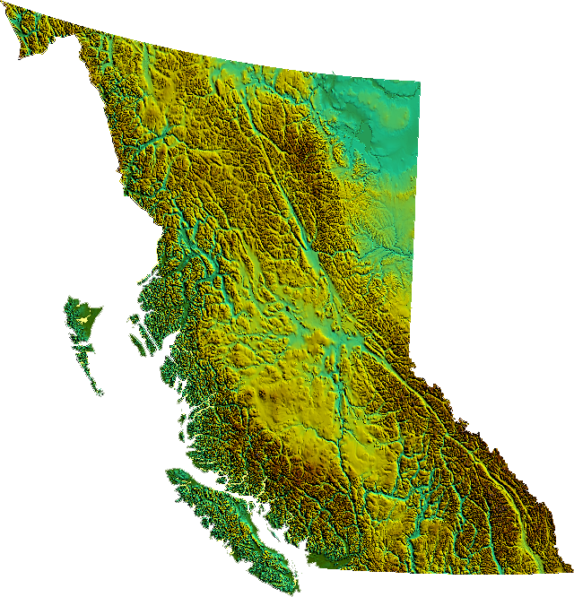
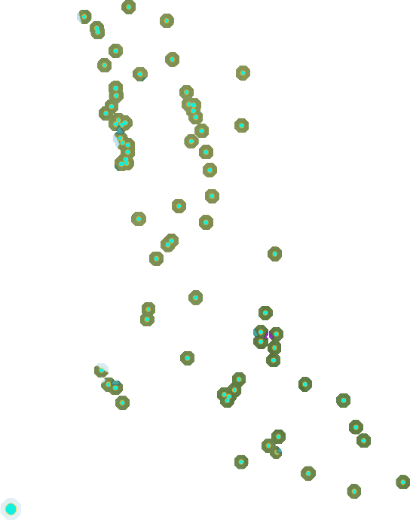
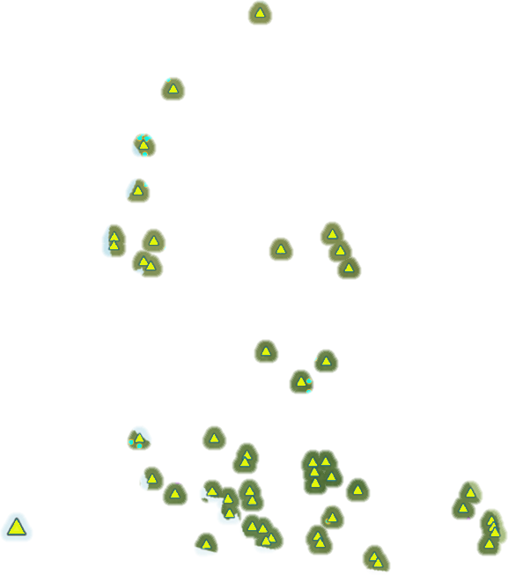
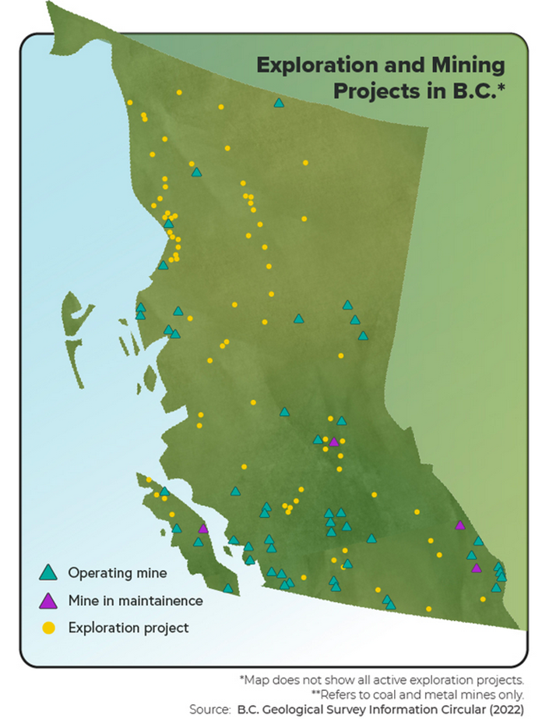
Strategy
Reviving the lost traces of High-grade exploration results
in British Columbia to target new discoveries.
Strong Mining Ecosystem
326 active exploration Projects
$660 million exploration spending (2021)
1,442,319 meters of drilling
17 operating Mines
Geological Potential
A diverse range of commodities including precious, base, and industrial metals
$12.6 billion in Mineral Production in 2021
Effective Regulations
Ranked least risk jurisdiction in 2017 and 2019
Seen as a Tier 1 center for geological, financial, environment, and social expertise
Lasting Indigenous Partnerships
Exploration and mining account for over 2/3 of all Indigenous employment in the sector
Infrastructure For Mining
Ocean Ports, Hydroelectric Power, All-season highways
Choice Destination for Responsibility Sources Metals
Progressive Climate policies
Skilled Labour
In Demand: B.C.’s Abundance of Critical Minerals
The province hosts many of the minerals that are projected to be in global high demand
Why
British
Columbia?
Operating Mine
Exploration Project
Western Star Projects
CSE: WSR

Slide 5
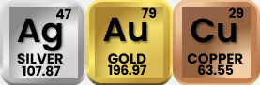
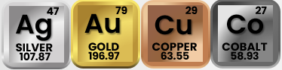
The Projects - 2 Key Assets
Western Star Property – Project I
Revelstoke - Mining District, British Columbia [V0G 1R2]
2,700 ha (27 Km2) - District Scale
100% Owned and permitted
CRD – Carbonate Replacement Deposit; precious metals rich
over 6.2 km Mineralized strike length
limited results to date, by surficial prospecting in well exposed areas
246.76 g/t silver, 1 to 50.1% lead, 8.22 g/t Au, 3.68% Cu - High Grade Samples
Toad River - Project II
Fort Nelson; British Columbia [V0C 1R0]
2,200 Ha (22 km²) on 2 mineral licenses
100% Owned
Vein Type Copper or Iron Oxide-Copper-Gold-Uranium
2 past mines in 15Km radius
14.8% Cu over 1.13M; 15.6% Cu over 0.61M; 13.8% Cu over 0.15M - Chip Samples assayed
2x High-Grade
with polymetallic mineralisation
CSE: WSR

Slide 6
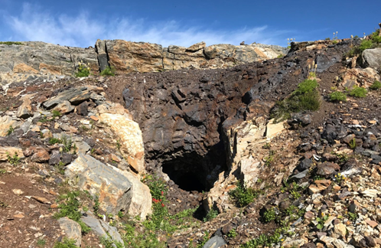
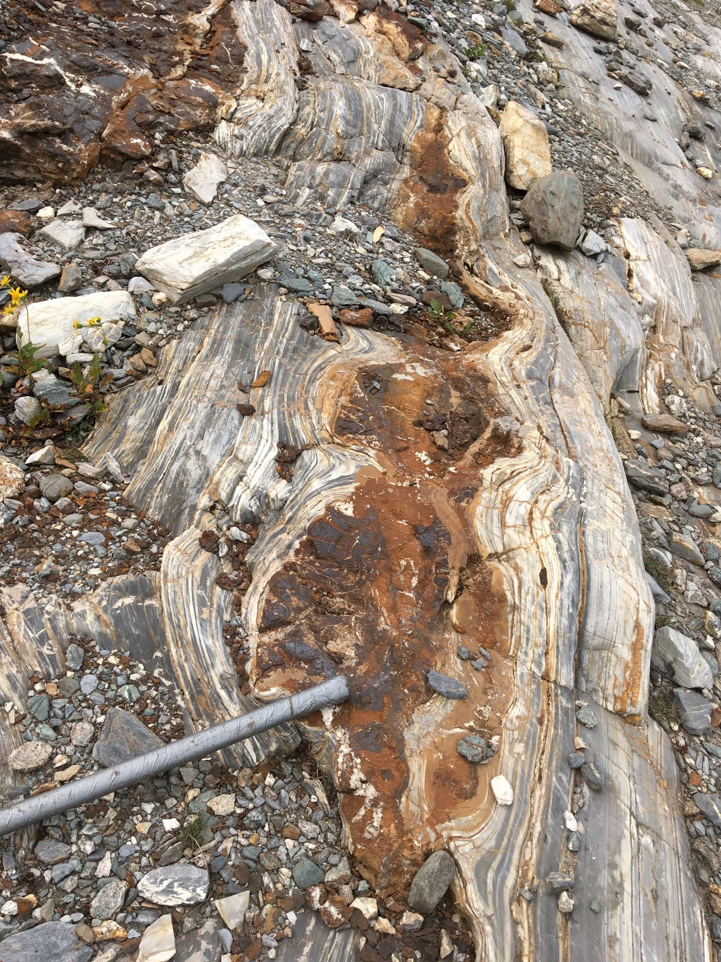
Western Star - Mineralization
Carbonate Replacement Deposit (CDR) mineralization occurs on the Western Star Property and is likely to be a combination of structure, lithology, and stratigraphy. There are three main CRD deposit types: Leadville-type mineralization (LTM), sedimentary exhalative (SEDEX) and Mississippi Valley-type (MVT).
Sulphide mineralization is stratiform and occurs at the contact between a grey-green phyllite and a limestone.
The massive chlorite and chloritic quartz that occurs along fractures and at the base of mineralization may be hydrothermal in origin.
The pods of disseminated hematite and magnetite that occur at the mineralized horizon are commonly associated with volcanogenic mineralization.
Pinch outs of the carbonate bank and dolomitized limestone units at the apparent unconformity can be expected to occur at intervals all along the contact to other units. In this area, the unconformity appears in at least three parallel zones or "Leads" on the flanks of large northwest trending folds.
Within the Kootenay Arc, significant lead-zinc+/-silver mineralization has been documented with limestone horizons, as well as high grade silver veins. The Cambrian Badshot Formation, a 50–100 m thick limestone horizon, extends almost the entire length of the Arc, and hosts most of the larger mineral deposits. This unit has been repeated throughout the area.
CSE: WSR
6

Slide 7
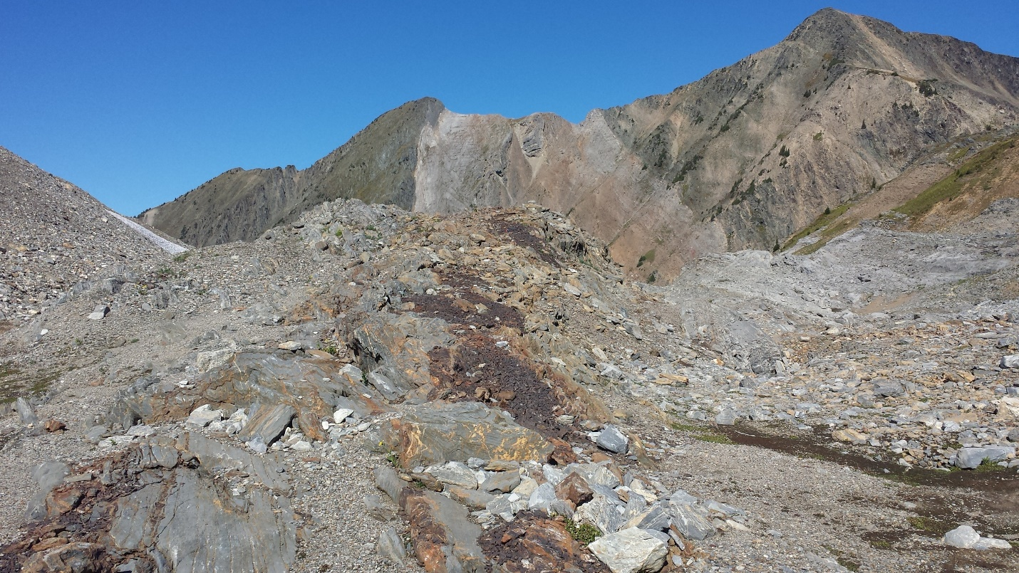
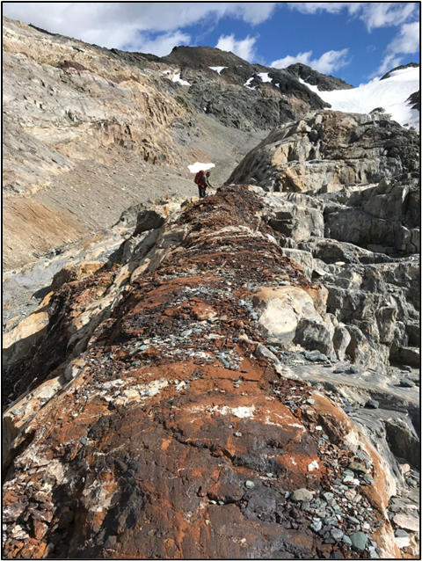
300m
Limestone unit within the Index Formation exposure in opposing slope is evident by recessive weathering and colour.
The dark gossan iron gravel running through the center of the picture mark the location of limestone replacement, hosting pods and stringers of galena and sphalerite mineralization. The mineralization has been traced over 6.2 km.
Orange veins next to the gossan is ankerite alteration of carbonate veins within limestone.
CSE: WSR
7

Slide 8
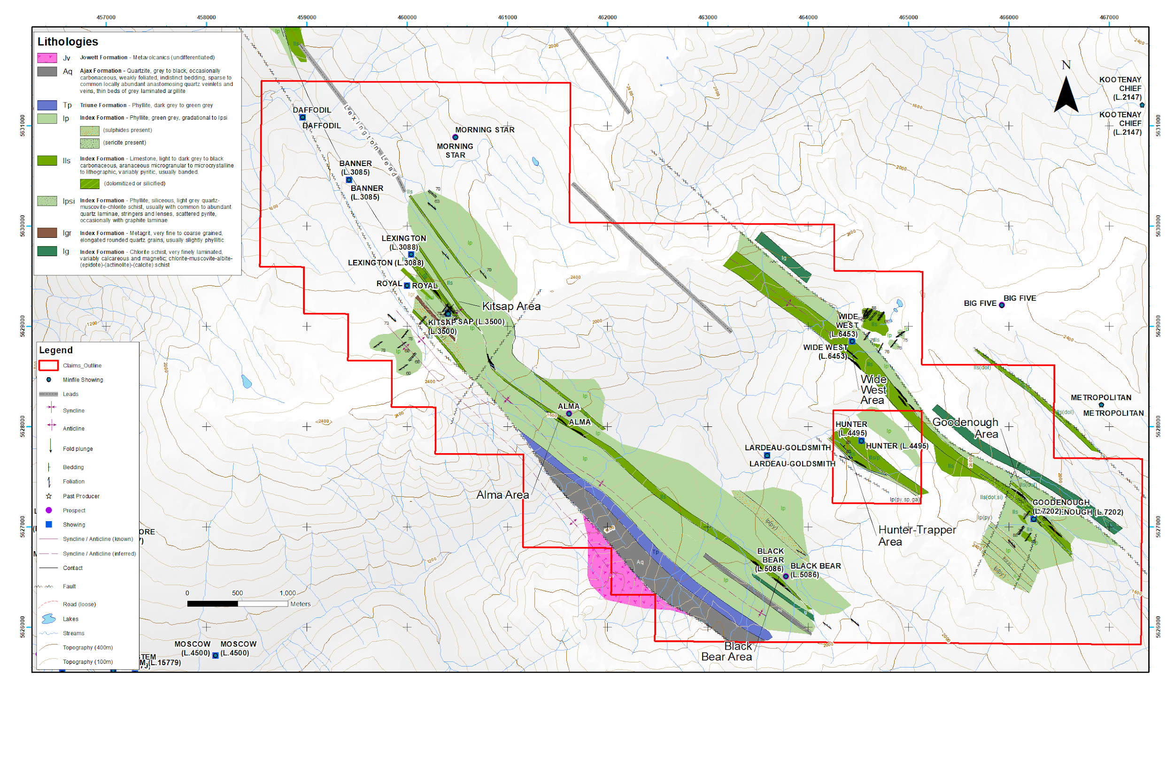
Western Star – Targets
The 2,797 ha Western Star Property is located 50 km southeast of Revelstoke, BC.
There are eleven Documented Mineral Showings on the Property:
Black Bear
Lardeau-Goldsmith
Wide West
Goodenough
Kitsap
Banner
Daffodil
Royal
Morning Star
Lexington
Alma
CSE: WSR
8

Slide 9
Minfile Showings
Goodenough
Mineralization consists of galena-sphalerite-chalcopyrite in concordant to irregular quartz-chlorite veins in shears at the limestone-phyllite contact and in fractured and/or brecciated ankeritic limestone over a strike length of 160 m.
22 rock samples returned up to 8.22 g/t gold, 246.76 g/t silver, and 33.43% lead.
Daffodil
Mineralization in a series of occurrences along strike to the southeast and consists of intermittent lenses of galena-sphalerite in crosscutting fractures and quartz-carbonate veins within siderite or ankerite alteration zones. Alteration consists of sericitization of phyllite, ankerite-siderite alteration of dolomite and dolomite alteration of limestone.
Black Bear
Consists of massive pyrite with minor galena-sphalerite in quartz gangue. Float in a boulder train is of siliceous pyritic dolomite with disseminated magnetite and traces of galena and sphalerite. In 1896, a shaft was sunk 3 metres. A series of open cuts follow the mineralization. In 1900, the vein was trenched and mined and reported to average 5.4 metres wide and to be composed of concentrating ore. A tunnel was driven a distance of 30 meters. Samples have returned 2.21 g/t gold and 6.16% lead.
Wide West
Quartz veins containing lead, copper, and gold values were investigated with 156 metres of underground workings. Mineralization consists of pods of galena-sphalerite in quartz veins at ankeritic limestone-phyllite contacts. 35 rock samples in the Wild West area returned up to 50.1 % lead. Several of the samples returned ore grade values of up to 50.1% lead as well as 181g/t silver, and 3.68% copper.
CSE: WSR
9

Slide 10
Minfile Showings
Morning Star
Consists of a 2.1-meter-wide vein striking 3100 to 3200, dipping 62o to 750 east. The vein is conformable to the enclosing rocks and contains pyrite, galena, and sphalerite in a gangue of limestone and quartz. The vein is highly oxidized at surface with pyrite and galena leached out.
Lexington
A 3.6 m wide quartz vein contains 1.5 m of massive galena in the footwall which returned high silver values.
Soil geochemical data reveals a high of 17.4 ppm silver, 850 ppm lead ,and 1,450 ppm zinc. Geophysical data shows a 40-gamma mag high followed by a 20-gamma mag low, coincident with a field strength high at the eastern side of the geochemical anomaly.
Lardeau Goldsmith
Reported to have high grade silver ore; a 15-metre adit was driven in 1899. It is inferred that mineralization is similar to nearby showings consisting of pyrite, galena, and sphalerite.
Kitsap
Mineralization consists of intermittent lenses of galena-sphalerite in crosscutting fractures and quartz-carbonate veins within siderite or ankerite alteration zones. Alteration consists of sericitization of phyllite, ankerite-siderite alteration of dolomite and dolomite alteration of limestone. Nine rock samples returned from 424 ppm to 44.70% lead, along with 224 g/t silver, and 2,950 ppm zinc.
CSE: WSR
10

Slide 11
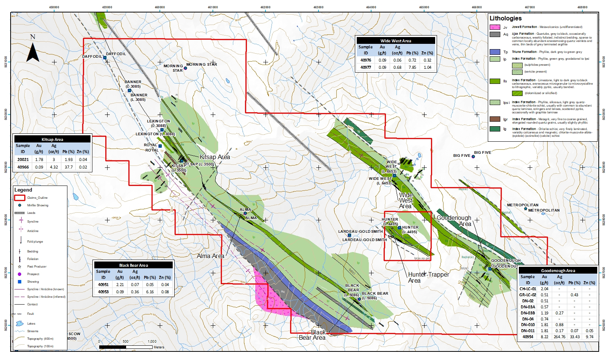
Lithology and Mineralization
CSE: WSR
11

Slide 12
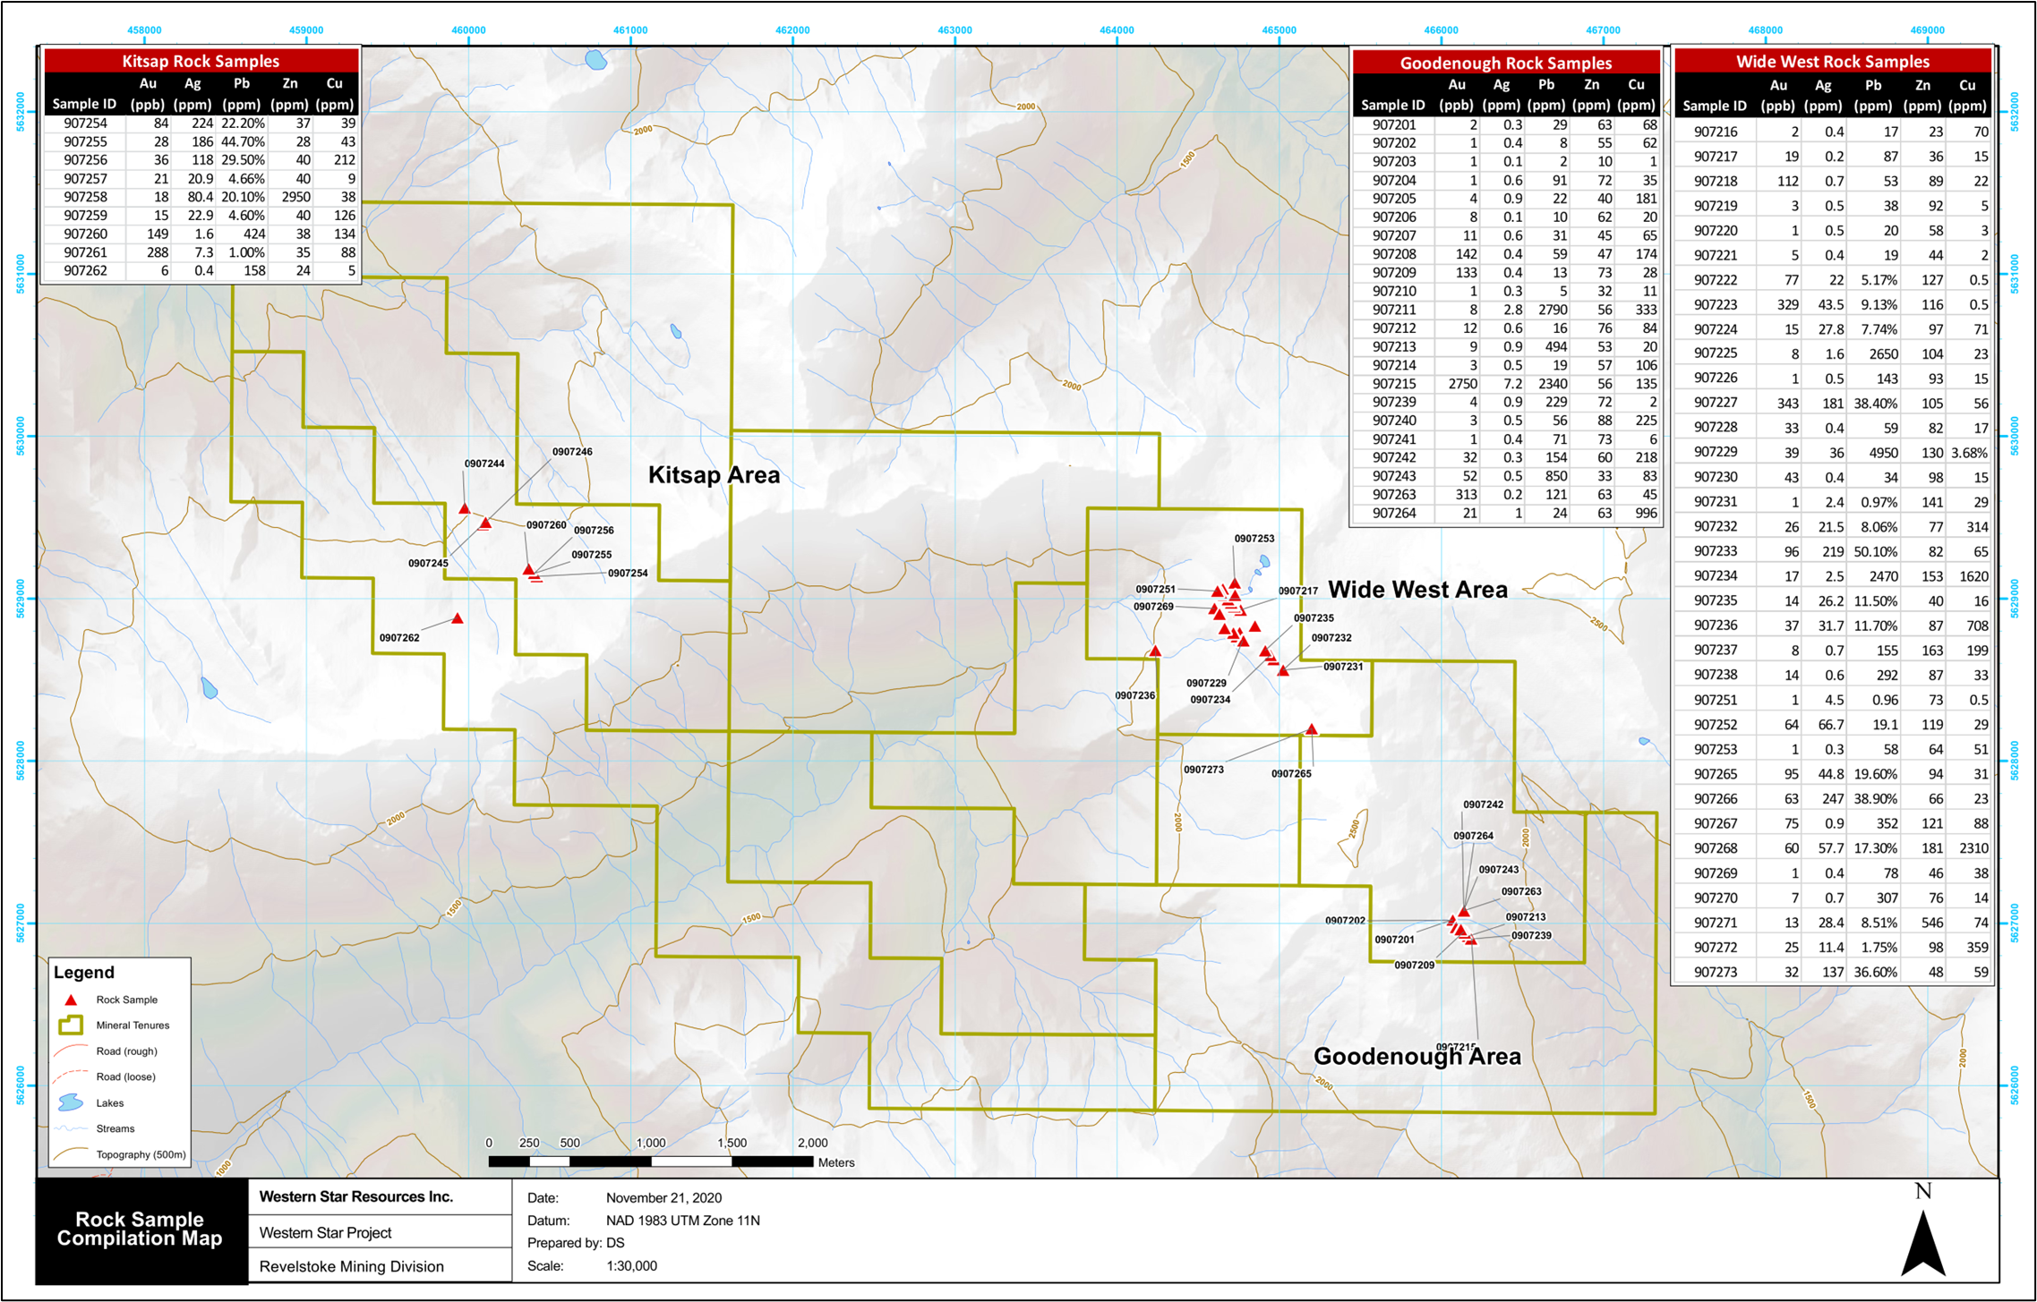
Initial Program Results
CSE: WSR
12

Slide 13
Mineralization
Mineralization occurs as both disseminated and massive zones of galena, pyrite, and sphalerite associated with dolomitized limestone and silicification invariably developed within siderite rich zones containing hematite and magnetite localized along distinct, limestone-chlorite schist contacts.
Mineralized zones form "cigar like' bodies ( >1 m to > 5 m in width) in fold hinges and generally contain grades of up to 246.76 g/t silver, 1 to 50.1% lead, 8.22 g/t Au, 3.68% Cu and associated zinc values.
Three distinct, northwest striking limestone-chlorite schist contact zones spaced at roughly 1-kilometer intervals are termed, from west to east: the Lexington Lead; the Trapper Lead, and the Goodenough Lead. These zones all host similar mineralization and may represent either folded repetitions of the same contact or stratigraphic repetitions of similar depositional environments.
To date, exploration of these showings has been limited to historical mining and surficial prospecting in well exposed areas and no attempt has been made to test the possible overburden covered strike extensions or down dip extensions of the known mineralization which extends over 6.2 km.
13
CSE: WSR
13

Slide 14
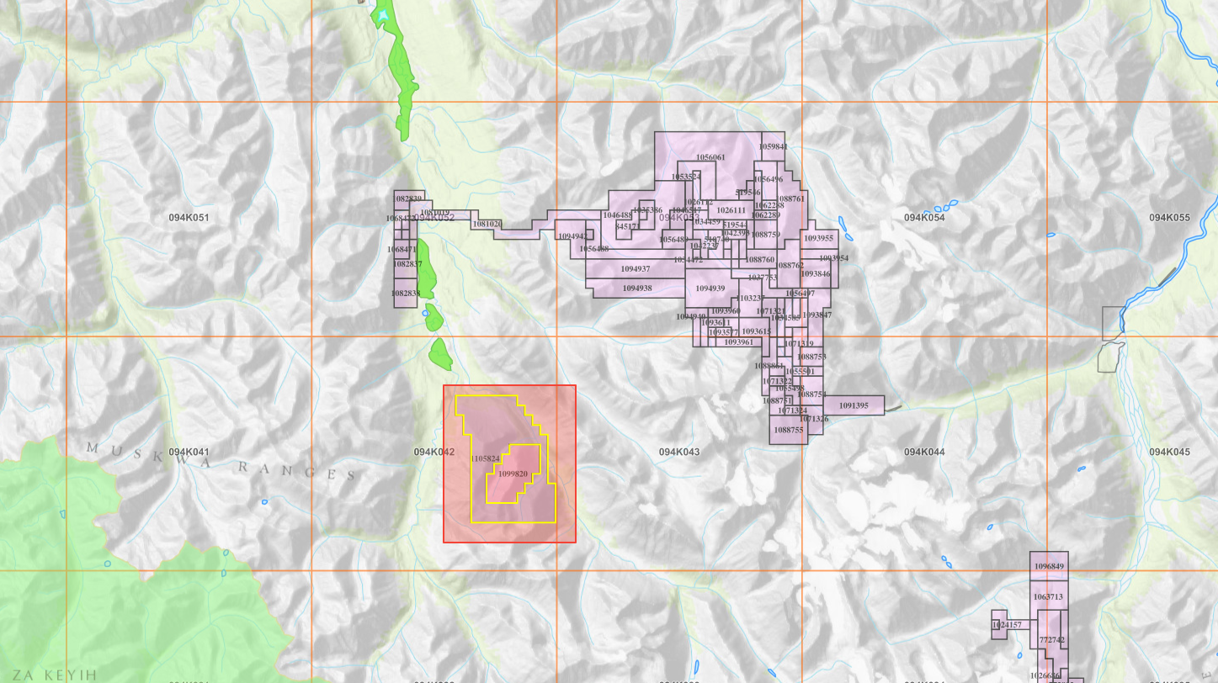
Toad River Project
The 2,200 Ha Toad River Property is 56 km south of Muncho Lake, BC.
2 historical mines in 15Km radius
Historically proven mining district
CSE: WSR
14

Slide 15
Toad River - Mineralization
Rock Samples Assayed:
Potential Vein Type Copper or Iron Oxide-Copper-Gold-Uranium
Mineralization and/or polymetallic mineralization associated with an IOCG-type deposit.
Cobalt bearing mineral in Vein systems (Erythrite), Cobalt was never assayed for
Potential vein-type copper
Copper mineralization occurs in quartzcarbonate veins closely associated with mafic dikes both spatially and in time
Nearby historic mines; past producting Churchill Copper Mine and Eagly Vein demonstrate that the mineralizing system in the area carries economic grades and quantities of copper
Sample ID | Width | % CU
ME-1 | 4.4' | 4.1
ME-2 | 3.8' | 2.4
ME-3 | 0.5' | 13.8
ME-4 | 1.4' | 7.4
ME-5 | 1.0' | 4.8
ME-6 | 3.3' | 8.2
ME-7 | 2.0' | 1.07
ME-8 | 2.8' | 5.45
ME-9 | 2.8' | 2.7
ME-10 | 0.6' | 1.98
ME-11 | 2.0' | 15.6
ME-12 | 3.7' | 14.8
ME-13 | 1.0' | 2.4
ME-14 | 1.0' | 5.35
ME-15 | 2.2' | 1.55
CSE: WSR
15

Slide 16
Operations
Timeline
In Progress
CSE: WSR

Slide 17
Share Structure
Shares Issued & Outstanding | M 16.4
Warrants Outstanding | M 6.8
Fully Diluted | M 23.2
Market Capitalization | M ~2.2
Debt | 0.0
CSE: WSR

Slide 18
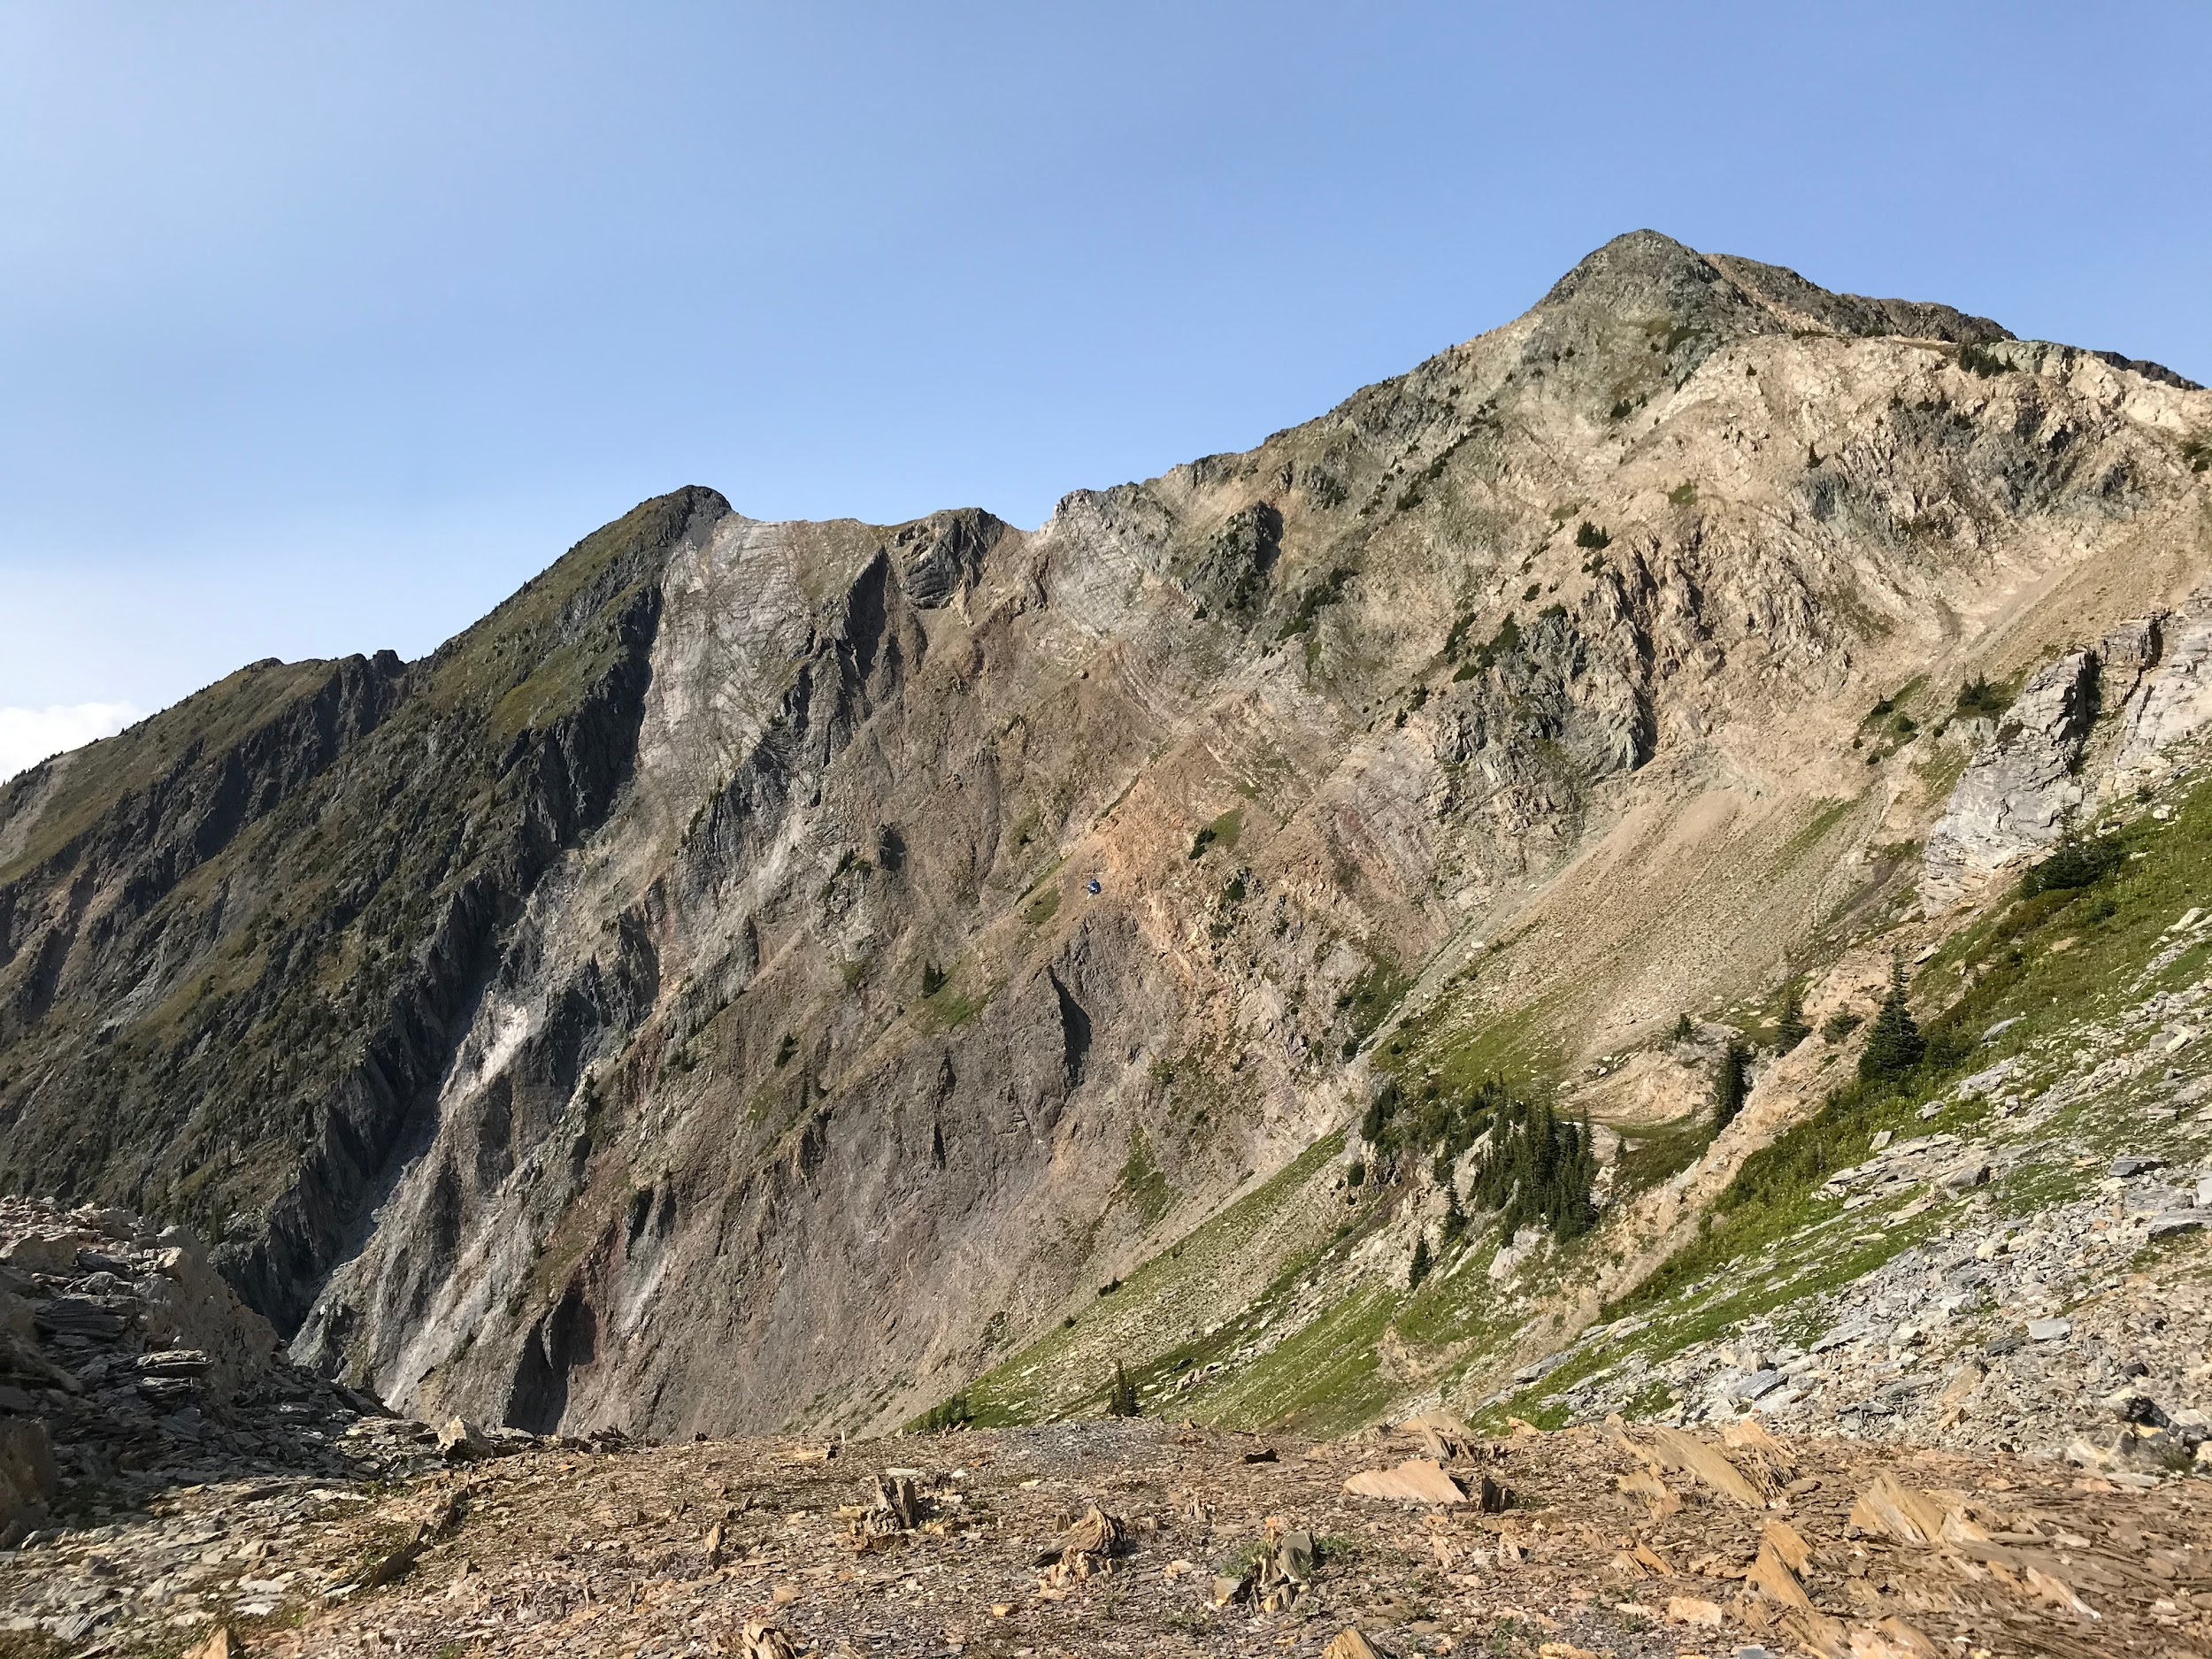
Western Star Resources Inc.
Contact: Blake Morgan
Phone: +1 236 878 4938
Discovering Green Metals To Power New Technologies
WSR-CSE

